Slide 1
Statistics: A Tool For Social Research
Eleventh Edition
Joseph F. Healey

Slide 2
Hypothesis Testing I:
The One-Sample Case
Chapter 8

Slide 3
Learning Objectives
Explain the logic of hypothesis testing, including concepts of the null hypothesis, the sampling distribution, the alpha level, and the test statistic.
Explain what it means to “reject the null hypothesis” or “fail to reject the null hypothesis.”
Identify and cite examples of situations in which one-sample tests of hypotheses are appropriate.
Test the significance of single-sample means and proportions using the five-step model, and correctly interpret the results.
Explain the difference between one- and two-tailed tests, and specify when each is appropriate.
Define and explain Type I and Type II errors, and related each to the selection of an alpha level.
Use the Student’s t distribution to test the significance of a sample mean for a small sample.

Slide 4
Chapter Outline
An Overview of Hypothesis Testing
The Five-Step Model for Hypothesis Testing
Choosing a One-Tailed or Two-Tailed Test
Selecting an Alpha Level
The Student’s t Distribution
Tests of Hypothesis for Single-Sample Proportions (Large Samples)

Slide 5
In This Presentation
The basic logic of hypothesis testing
  Hypothesis testing for single sample means or proportions
  The Five-Step Model
Other material covered:
  One- vs. Two- tailed tests
  Type I vs. Type II error
  Student’s t distribution

Slide 6
Significant Differences
Hypothesis testing is designed to detect significant differences:
  differences that did not occur by random chance
  hypothesis testing is also called significance testing
This chapter focuses on the “one sample” case: we compare a random sample against a population
We compare a sample statistic to a (hypothesized) population parameter to see if there is a significant difference

Slide 7
Example (1 of 10)
The education department at a university has been accused of “grade inflation” so education majors have much higher GPAs than students in general
GPAs of all education majors should be compared with the GPAs of all students
  There are 1000s of education majors, far too many to interview
  How can the dispute be investigated without interviewing all education majors?

Slide 8
Example (2 of 10)
The average GPA for all students is 2.70 (μ) – this value is a parameter
The box reports the statistical information for a random sample of education majors
mean = | 3.00
s = | 0.70
N = | 117

Slide 9
Example (3 of 10)
There is a difference between the parameter (2.70) and the statistic (3.00)
  It seems that education majors do have higher GPAs
However, we are working with a random sample (not all education majors)
The observed difference may have been caused by random chance

Slide 10
Example (4 of 10)
Two explanations for the difference:
The sample mean (3.00) is the same as the population mean (2.70)
  The difference is trivial and caused by random chance
The difference is real (significant)
  Education majors are different from all students

Slide 11
Hypotheses
Null Hypothesis (H₀)
  “The difference is caused by random chance”
  H₀ always states there is “no significant difference”
Alternative hypothesis (H₁)
  “The difference is real”
  H₁ always contradicts H₀
One (and only one) of these explanations must be true, but which one?

Slide 12
Test the Explanations (1 of 3)
Assume the H₀ is true
  What is the probability of getting the sample mean (2.70) if the H₀ is true and all education majors really have a mean of 3.00?
  If the probability is less than 0.05, reject the null hypothesis

Slide 13
Test the Explanations (2 of 3)
Use the 0.05 value as a guideline to identify differences that would be rare if H₀ is true
Use the Z score formula and Appendix A to determine the probability of getting the observed difference
If the probability is less than 0.05, the calculated or “observed” Z score will be beyond ±1.96 (the “critical” Z score)

Slide 14
Test the Explanations (3 of 3)
Substituting the values into the formula, we calculate a Z score of 4.62
This is beyond ±1.96
  A difference this large would be rare if H₀ is true
Reject H₀

Slide 15
Basic Logic
This difference is statistically significant
The GPA of education majors is significantly different from the GPA of the general student body

Slide 16

Example (5 of 10)
Effectiveness of rehabilitation center for alcoholics
Absentee rates for sample and community:
Community | Sample of Treated Alcoholics
µ = 7.2 days per year | = 6.8 days per year
σ = 1.43 | N = 127

Slide 17
Example (6 of 10)
Main question: Does the population of all treated alcoholics have different absentee rates than the community as a whole?
What is the cause of the difference between 6.8 and 7.2?
  Real difference?
  Random chance?

Slide 18
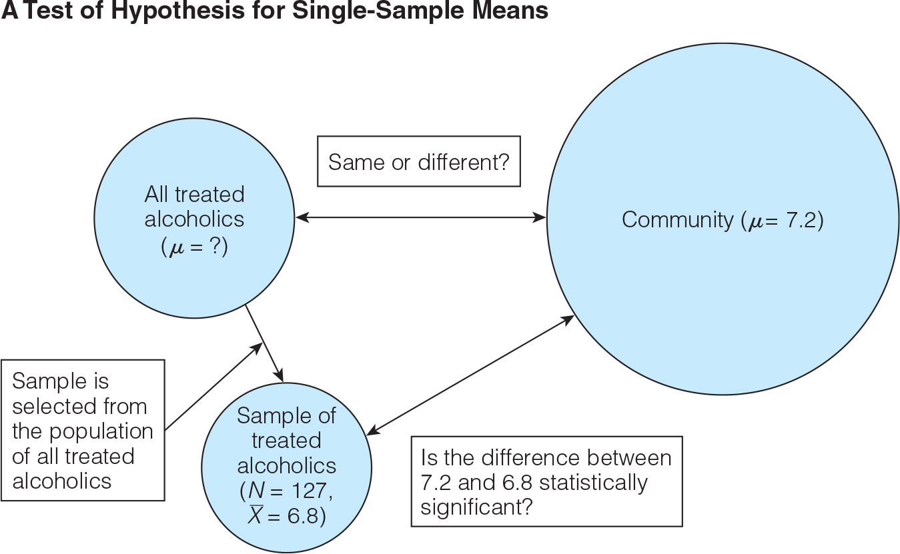
Example (7 of 10)

Slide 19
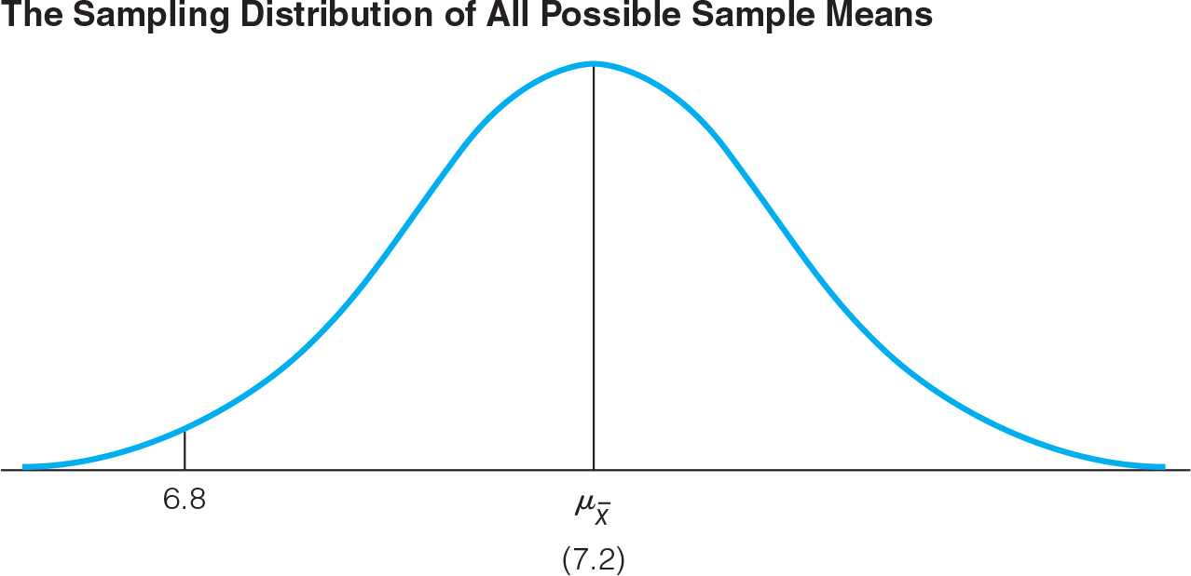
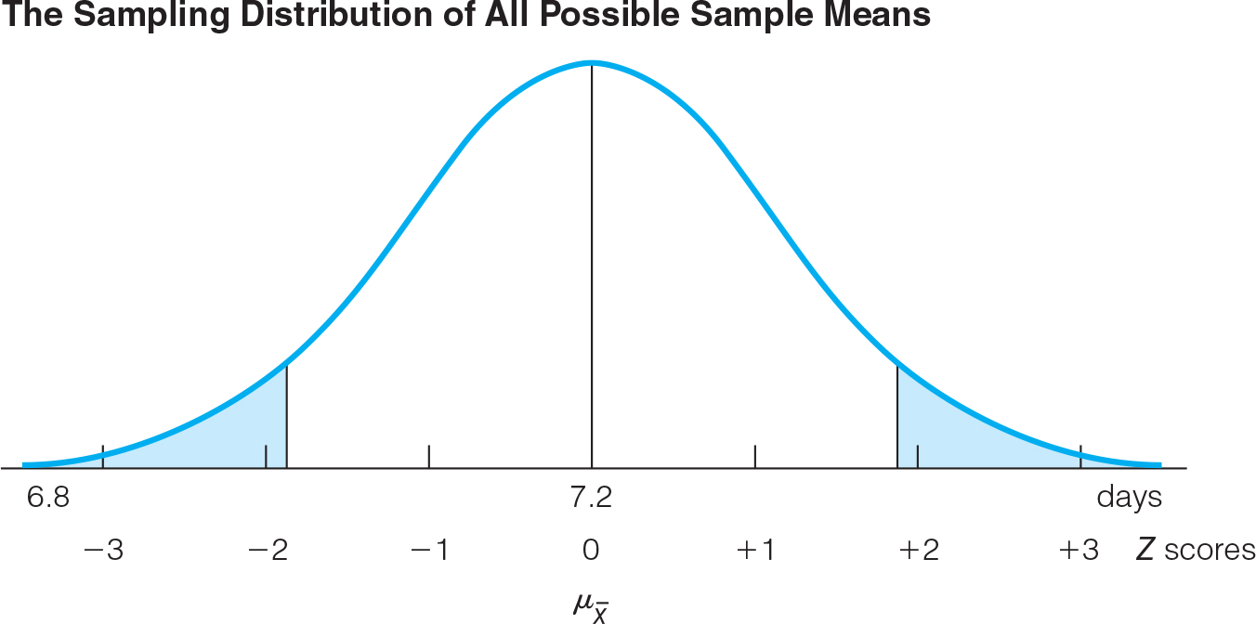
Example (8 of 10)
H_{o}: μ = 7.2 days per year

Slide 20
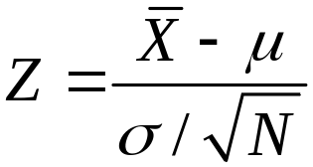
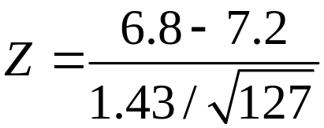
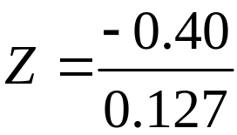

Example (9 of 10)
FORMULA 8.1

Slide 21
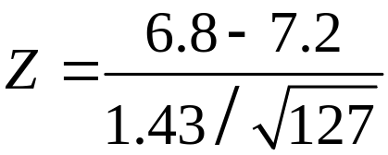
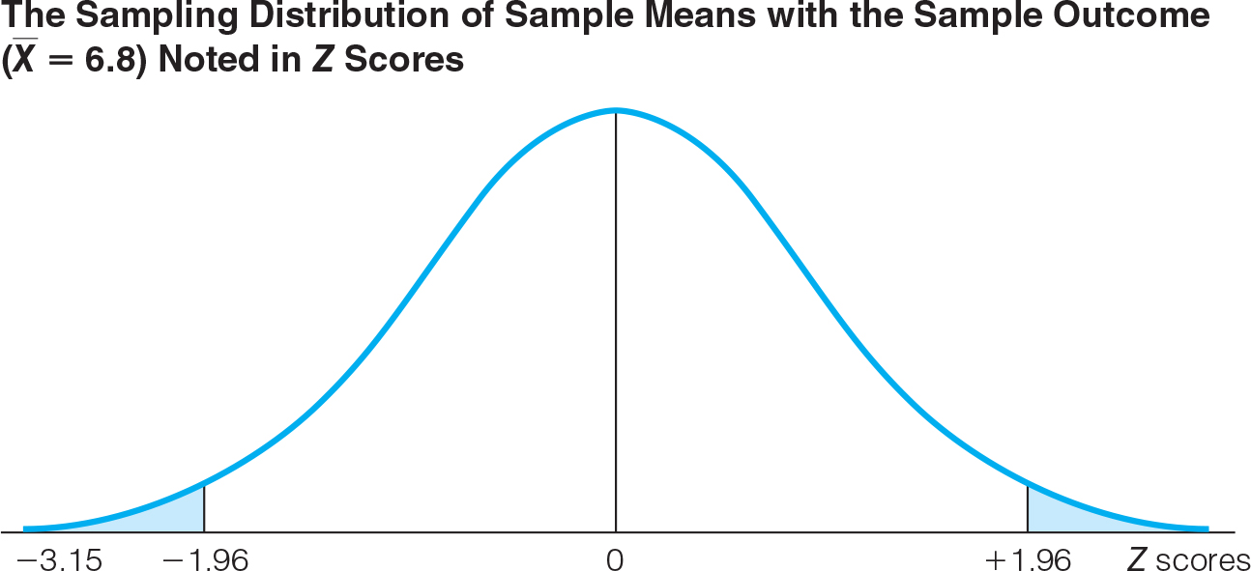
Example (10 of 10)
The sample outcome (−3.15) falls in the shaded area, thus we reject H_{o}

Slide 22
The Five-Step Model
Make assumptions and meet test requirements
State the null hypothesis (H_{o})
Select the sampling distribution and establish the critical region
Compute the test statistic
Make a decision and interpret the results of the test

Slide 23
The Five-Step Model: Example
The education department at a university has been accused of “grade inflation” so education majors have much higher GPAs than students in general
The mean GPA for all students is 2.70 (μ)
A random sample of 117 (N) education majors has a mean GPA of 3.00, with a standard deviation (s) of 0.70

Slide 24
Step 1: Make Assumptions and Meet Test Requirements (1 of 2)
Random sampling
  Hypothesis testing assumes samples were selected according to EPSEM
  The sample of 117 was randomly selected from all education majors
Level of measurement is interval-ratio
  GPA is an interval-ratio level variable, so the mean is an appropriate statistic
Sampling distribution is normal in shape
  This is a “large” sample (N ≥ 100)

Slide 25
Step 2: State the Null Hypothesis (1 of 2)
H_{o}: μ = 2.7
  The sample of 117 comes from a population that has a GPA of 2.7
  The difference between 2.7 and 3.0 is trivial and caused by random chance
H₁: μ ≠ 2.7
  The sample of 117 comes from a population that does not have a GPA of 2.7
  The difference between 2.7 and 3.0 reflects an actual difference between education majors and other students

Slide 26
Step 3: Select Sampling Distribution and Establish the Critical Region (1 of 2)
Sampling Distribution= Z
  Alpha (α) = 0.05
  Alpha is the indicator of “rare” events
  Any difference with a probability less than α is rare and will cause us to reject the H_{o}
Critical region begins at ±1.96
  This is the critical Z score associated with a two-tailed test and alpha equal to 0.05
  If the obtained Z score falls in the critical region, reject H_{o}

Slide 27
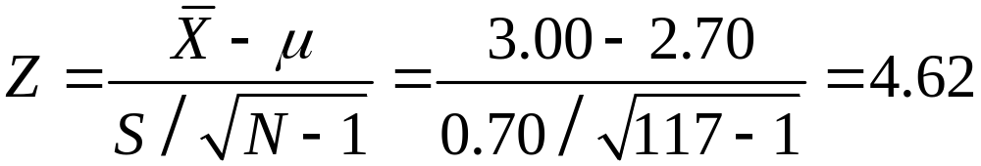
Step 4: Compute the Test Statistic (1 of 2)
  Z (obtained) = 4.62

Slide 28
Step 5: Make a Decision and Interpret
Results (1 of 2)
The obtained Z score fell in the critical region so we reject the H_{o}
  If the H₀ were true, a sample outcome of 3.00 would be unlikely
  Therefore, the H_{o} is false and must be rejected
Education majors have a GPA that is significantly different from the general student body

Slide 29
The Five Step Model: Summary (1 of 2)
In hypothesis testing, we try to identify statistically significant differences that did not occur by random chance
In this example, the difference between the parameter 2.70 and the statistic 3.00 was large and unlikely (p < 0.05) to have occurred by random chance

Slide 30
The Five Step Model: Summary (2 of 2)
We rejected the H_{o} and concluded that the difference was significant
It is very likely that education majors have GPAs higher than the general student body
Making a Decision in Step 5 and Interpreting the Results of the Test
Situation | Decision | Interpretation
The test statistic is in the critical region | Reject the null hypothesis (H₀) | The difference is statistically significant
The test statistic is not in the critical region | Fail to reject the null hypothesis (H₀) | The difference is not statistically significant

Slide 31
Crucial Choices in Five-Step Model
Model is fairly rigid, but there are two crucial choices:
  One-tailed or two-tailed test
  Alpha (α) level

Slide 32


Choosing a One or Two-Tailed Test (1 of 5)
Two-tailed: States that population mean is “not equal” to value stated in null hypothesis
One-tailed: Differences in a specific direction
  Examples:

Slide 33
Choosing a One or Two-Tailed Test (2 of 5)
One- vs. Two-Tailed Tests, α = 0.05
If the Research Hypothesis (H₁) Uses | The test is | Concern is on | Z(critical) is
= | two-tailed | Both tails | ± 1.96
> | one-tailed | Upper tail | + 1.65
< | one-tailed | Lower tail | − 1.65
Finding Critical Z Scores for One-Tailed Tests
Alpha | Two-Tailed Value | One-Tailed Value Upper Tail | Lower Tail
0.10 | ±1.65 | +1.29 | −1.29
0.05 | ±1.96 | +1.65 | −1.65
0.01 | ±2.58 | +2.33 | −2.33
0.001 | ±3.32 | +3.10 | −3.10
0.0001 | ±3.90 | +3.70 | −3.70

Slide 34
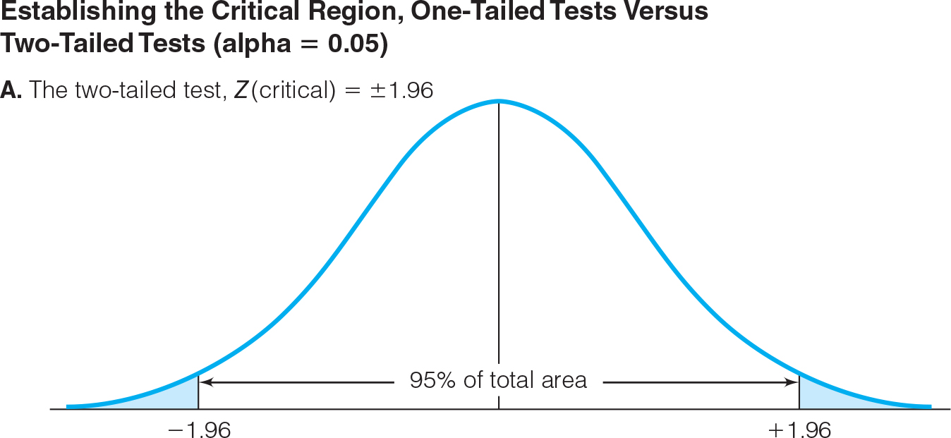
Choosing a One or Two-Tailed Test (3 of 5)

Slide 35
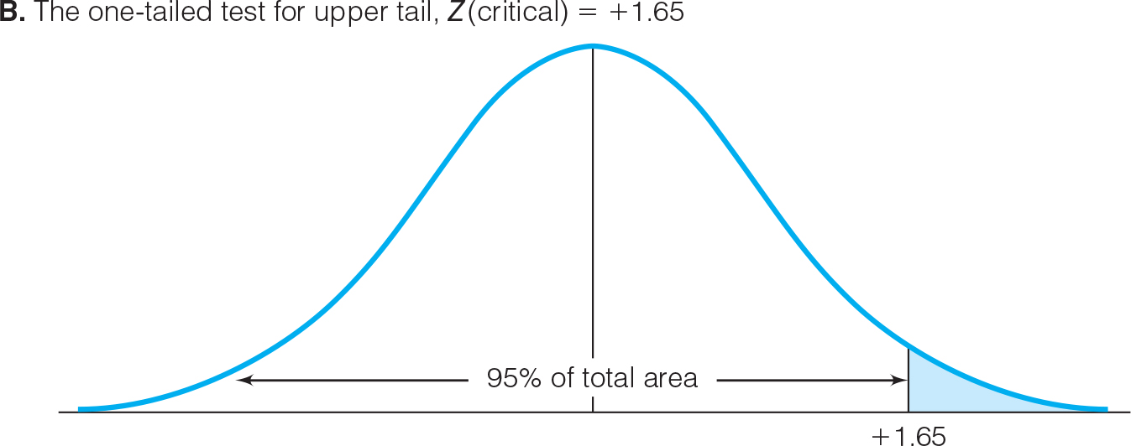
Choosing a One or Two-Tailed Test (4 of 5)

Slide 36
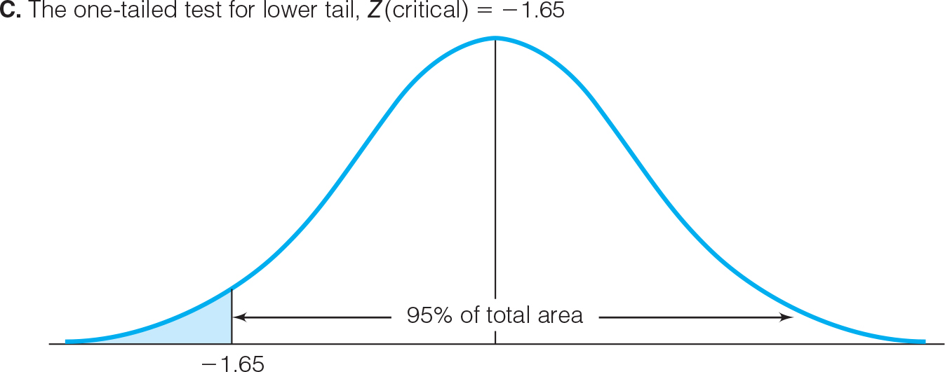
Choosing a One or Two-Tailed Test (5 of 5)

Slide 37
Selecting an Alpha Level
By assigning an alpha level, one defines an “unlikely” sample outcome
Alpha level is the probability that the decision to reject the null hypothesis is incorrect
Examine this table for critical regions:
The Relationship Between Alpha and Z(critical) for a Two-Tailed Test
If Alpha = | The Two-Tailed Critical Region Will Begin at Z(critical) =
0.10 | ±1.65
0.05 | ±1.96
0.01 | ±2.58
0.001 | ±3.32

Slide 38
Type I and Type II Errors
Type I, or alpha error:
  Rejecting a true null hypothesis
Type II, or beta error:
  Failing to reject a false null hypothesis
Examine table below for relationships between decision making and errors
Decision Making and the Five-Step Model
 | If our decision is to | And the H₀ is actually | The result is
a | Reject the H₀ | False | OK
b | Fail to reject the H₀ | True | OK
c | Reject the H₀ | True | Type I or alpha (α) error
d | Fail to reject the H₀ | False | Type II or beta (β) error

Slide 39
The Student’s t Distribution (1 of 2)
How can we test a hypothesis when the population standard deviation (σ) is not known, as is usually the case?
  For large samples (N ≥ 100), can use the sample standard deviation (s) as an estimator of the population standard deviation (σ)
    Use standard (Z) normal distribution
  For small samples, s is too biased an estimator of σ so do not use standard normal distribution
    Use Student’s t distribution

Slide 40
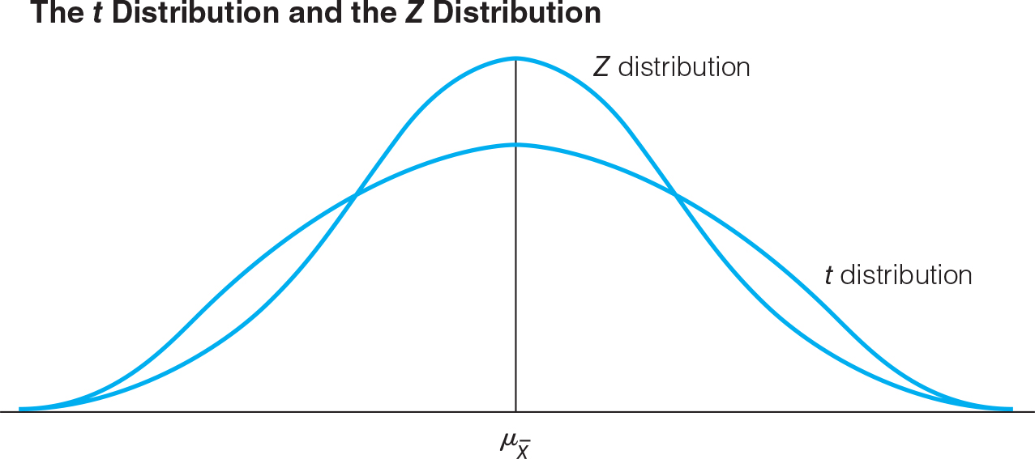
The Student’s t Distribution (2 of 2)
Compare the Z distribution to the Student’s t distribution:

Slide 41
The Student’s t Distribution
Choosing a Sampling Distribution When Testing Single-Sample Means
for Significance
If Population Standard Deviation (σ) is | Sampling Distribution is the
Known | Z distribution
Unknown and sample size (N) is large | Z distribution
Unknown and sample size (N) is small | t distribution

Slide 42
Student’s t: Using Appendix B
How t table differs from Z table:
Column at left for degrees of freedom (df)
  df = N – 1
Alpha levels along top two rows: one- and two-tailed
Entries in table are actual scores: t(critical)
  Mark beginning of critical region, not areas under the curve

Slide 43
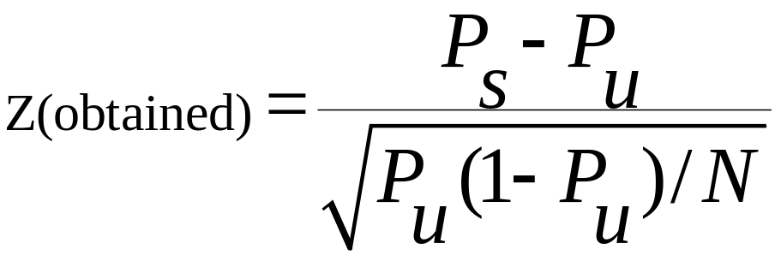
The Five-Step Model: Proportions (1 of 2)
When analyzing variables that are not measured at the interval-ratio level (and therefore a mean is inappropriate), we can test a hypothesis on a one sample proportion instead
The five step model remains primarily the same, with the following changes:
  The assumptions are: random sampling, nominal level of measurement, and normal sampling distribution
  The formula for Z(obtained) is:

Slide 44
The Five-Step Model: Proportions (2 of 2)
A random sample of 122 households in a low-income neighborhood revealed that 53 (P_{s} = 0.43 = 53/122) of the households were headed by women
In the city as a whole, the proportion of women-headed households is 0.39 (P_{u})
Are households in lower-income neighborhoods significantly different from the city as a whole?
Conduct a 90% hypothesis test (alpha = 0.10)

Slide 45
Step 1: Make Assumptions and Meet Test Requirements (2 of 2)
Random sampling
  Hypothesis testing assumes samples were selected according to EPSEM
  The sample of 122 was randomly selected from all lower-income neighborhoods
Level of measurement is nominal
  Women-headed households is measured as a proportion
Sampling distribution is normal in shape
  This is a “large” sample (N ≥ 100)

Slide 46
Step 2: State the Null Hypothesis (2 of 2)
H_{o}: P_{u} = 0.39
  The sample of 122 comes from a population where 39% of households are headed by women
  The difference between 0.43 and 0.39 is trivial and caused by random chance
H₁: P_{u} ≠ 0.39
  The sample of 122 comes from a population where the percent of women-headed households is not 39
  The difference between 0.43 and 0.39 reflects an actual difference between lower-income neighborhoods and all neighborhoods

Slide 47
Step 3: Select Sampling Distribution and Establish the Critical Region (2 of 2)
Sampling Distribution= Z
Alpha (α) = 0.10 (two-tailed)
Critical region begins at ±1.65
  This is the critical Z score associated with a two-tailed test and alpha equal to 0.10
  If the obtained Z score falls in the critical region, reject H_{o}

Slide 48
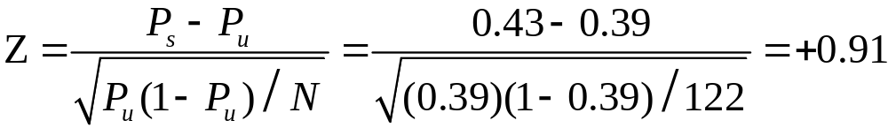

Step 4: Compute the Test Statistic (2 of 2)

Slide 49
Step 5: Make a Decision and Interpret
Results (2 of 2)
The obtained Z score did not fall in the critical region so we fail to reject the H_{o}
  If the H₀ were true, a sample outcome of 0.43 would be likely
  Therefore, the H_{o} is not false and cannot be rejected
The population of women-headed households in lower-income neighborhoods is not significantly different from the city as a whole

